Slide 1
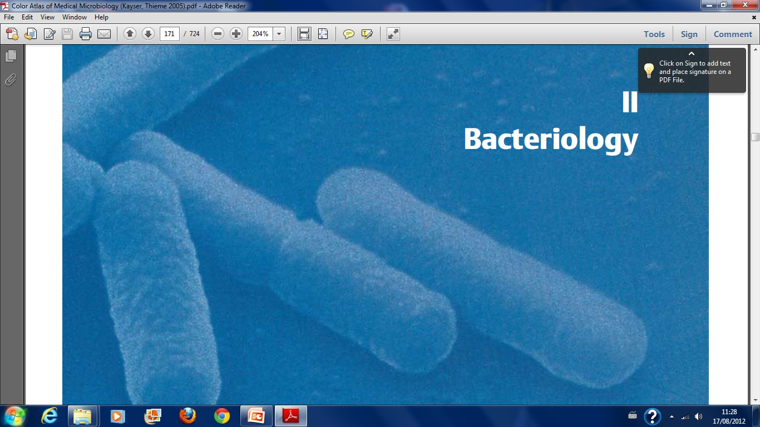
BACTERIOLOGY

Slide 2
BACTERIOLOGY
This is the study of bacteria
MORPHOLOGY OF BACTERIA
Bacteria are free living microscopic, unicellular organisms capable of performing all the essential functions of life e.g growth, metabolism and reproduction.
They poses both deoxyribonucleic acid (DNA) and ribonucleic acid (RNA) and lack chlorophyll.
Belong to the kingdom Protista
This kingdom has further been divided into eukaryotes and prokaryotes

Slide 3
CONT’
Bacteria is a prokaryote.
The approximate size is 1micrometre in diameter.
Grows on ordinary media
Replication is by binary fission
Has no endoplasmic reticulum, ribosomes free in the cytoplasm or attached to the cell membrane, no mitochondria present

Slide 4
SHAPE OF BACTERIA
Bacteria exist in different shapes.
1. Cocci-are round or oval cells
Diagram (coccus)
2. Bacilli-are rod or stick-shaped
Diagram (bacillus)
In some of the bacilli the length of the cells may be equal to width. Such forms are known as coccobacilli
Diagram (coccobacillus)
3. Vibrios-are curved or comma shaped
diag (vibrio)
4. Spirilla-are non-flexuous spiral forms with one to three fixed curves in their rigid bodies
Diag (spirillum)

Slide 5
CONT’
5.Spirochaetes-are slender and flexuous spiral forms
Diag (spirochaete)
6. Mycoplasma-are cell wall deficient organisms. Therefore , they do not posses stable morphology. They occur as round or oval bodies or as interlacing filaments.
GROUP PATTERNS
The most frequent method of reproduction among bacteria is asexual binary fission, that is, each cell splits in half, forming two new cells. As they increase in number they form distinct groups.

Slide 6
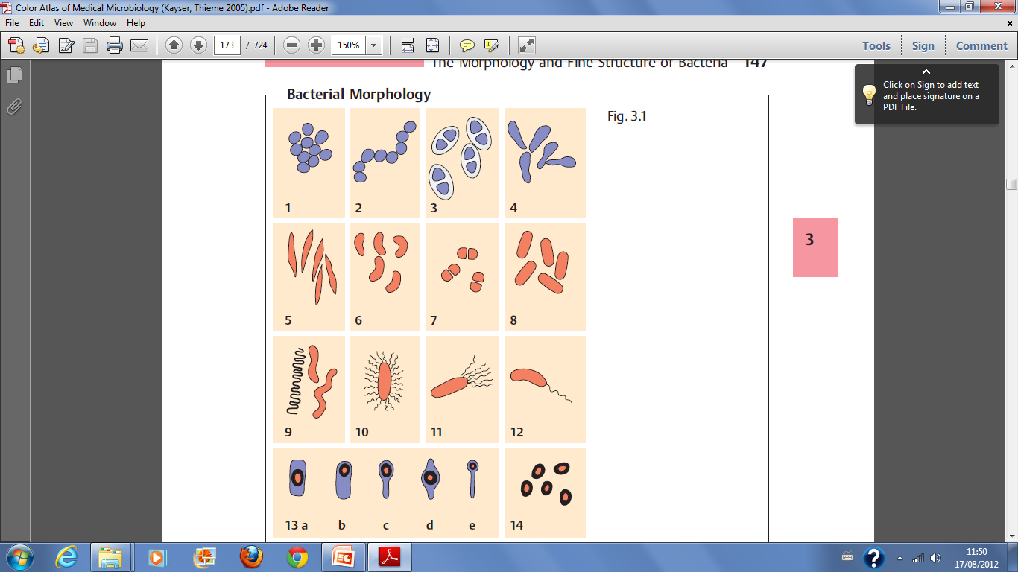

Slide 7
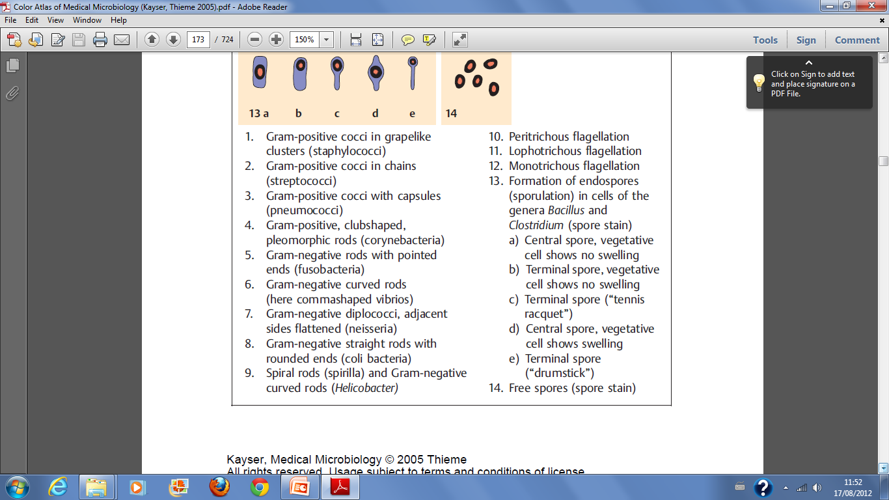

Slide 8
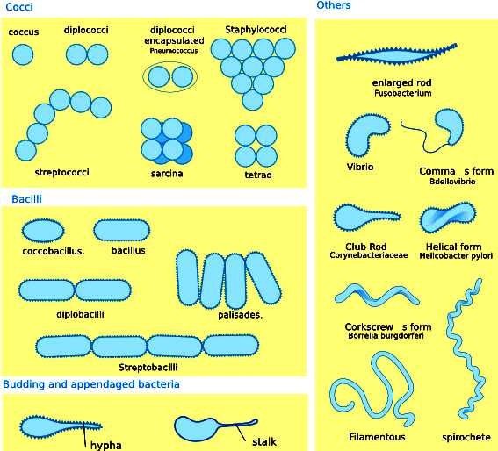

Slide 9
Based on association
Individual : occur as single cell
Diplo : occur in twos
Staphylo: occurs in clusters (group)
Strep: occurs in chains
Filamentous:

Slide 10
ANATOMY OF A BACTERIAL CELL-
ASSIGNMENT
Draw a well labelled diagram of a bacterial cell
Read and make notes on bacterial growth curve

Slide 11
REQUIREMENT FOR GROWTH AND DEVELOPMENT OF BACTERIA
For their optimal growth, bacteria require proper nutrients, oxygen, pH and temperature. Most of the bacteria of medical importance will grow only if a source of organic material as a nutrient is available.
Bacteria also require a source of nitrogen and a number of salts to have a supply of Potassium, Magnesium, Iron, Phosphate and Sulphate.
Minor concentrations of Calcium and Manganese are also required whereas growth is facilitated when trace quantities of Cobalt, Zinc, Chlorine, Copper and Nickel are present in the medium.

Slide 12
1. Oxygen
The need of Oxygen for a particular bacterium reflects it's mechanism to meet the requirement of energy. On this basis, bacteria have been divided into 4 groups:
Obligate anaerobes-these grow only under conditions of high reducing intensity. These bacteria lack catalase, Peroxiadase, Superoxide dismutase and cytochrome systems.
Facultative anaerobes-can grow under both aerobic and anaerobic conditions and include members of family enterobacteriaceae and many others
Obligatory aerobes-cannot grow unless oxygen is present in the medium e.g Pseudomonas
Microaephilic-can grow under conditions with low oxygen tension e.g Clostridium tetani

Slide 13
2. Temp
In regard to temperature, 3 groups are recognized
Psychrophilic-grow in the range of 5-30 degrees celcius with an optimum of 10-20 degrees
Mesophilic-grow best at 20-40 degrees with a range of 10-45 degrees.
All the medically important bacteria belong to this group. The optimum temp is 37 degrees
Thermophillic organisms-prefer high temperature 25-80 degrees for growth and yield maximum growth at 50-60 degrees

Slide 14
3) PH
-The pH range tolerated by most bacteria extends over 3-4 units but rapid growth is confined for 1 unit or less. Most pathogenic bacteriaa require a pH of 7.2-7.6 for their optimal growth.
Some like Lactobacilli grow at acidic pH while cholera vibrio grow at alkaline pH.
4) Carbon dioxide-some organisms such as pneumococci and gonococci grow better in air supplemented with 5-10% carbon dioxide

Slide 15
Light and other Radiations
Darkness provides a favourable condition for growth and viability of bacteria. UV rays from direct sunlight or a mercury lump are bacteriacidal. Bacteria are also killed by ionizing radiations.

Slide 16
IDENTIFICATION OF BACTERIA
Suitable criteria for the purpose of microbial identification include cell shape, gram reaction and the prescence or absence of specialized structures such as spores or flagella.
Most important duty of a medical microbiologist is isolation and accurate identification of disease causing micro-organisms from morbid material and its antibiotic susceptibility.

Slide 17
CONT’
Identification of the isolate is carried out by examination of stained and unstained smears of the morbid material, isolation in pure culture, study of macro and microscopic morphology of the isolate and biochemical characteristics.
Finally antibiotic susceptibility of the isolate is carried out and specific chemotherapy initiated.

Slide 18
CONT’
There are various techniques used:
i) Unstained Wet Film
Also called hanging drop.
Examined under a light microscope or dark-ground microscope for observation and demonstration of motility.

Slide 19
ii) Staining techniques
a) Gram stain
Most frequently used in diagnostic bacteriology. Dyes are used.
On the basis of their reaction to the gram stain, bacteria can be divided into two:
Gram positive
Gram negative
The gram positive retain the dye while the gram negative do not

Slide 20
b)Ziehl-Neelsen stain
Next to gram stain, this is the method that is most frequently used in diagnostic bacteriology.
It is of value in distinguishing a few bacterial species e.g tubercle bacilli, atypical mycobacteria, lepra bacilli and Nocardia

Slide 21
GRAM POSITIVE COCCI
STAPHYLOCOCCI
Genus staphyloccus contains 33 defined species, 20 of which are known to cause infection in man.
Morphology
Gram positive.
Spherical, about 0.8-1.0 micrometer in diameter
Arranged in grape-like clusters
Non-motile, non-flagellated, non-sporing and non-capsulated. However, a few strains are sporing.

Slide 22
CONT……
Are aerobes and facultative anaerobes
Optimum temp for growth is 37 degrees range 12-44
Optimum Ph 7.5
Are Beta-hemolytics in human blood they cause haemolysis of RBCs; excretes toxins

Slide 23
COMMON SPECIES OF STAPHYLOCOCCI
Staphylococcus aureus
Infections caused Staphylococcus aureus (pathogenicity)
Cutaneous infections
Wound and burn infections, pustules (small cutaneous abscess), furuncles and boils, large cutaneous abscess, stye, impertigo and pemphigus neonatorum
Deep infections
Osteomyelitis, Peritonitis, Tonsilitis, pharyngitis, sinusitis, bronchopneumonia, empyema, septicaemia, meningitis, endocarditis, breast abscess, renal abscess and abscess in other organs.

Slide 24
CONT…..
Food poisoning
Toxic shock syndrome caused by accumulation of toxins

Slide 25
b) Staphylococcus epidermidis
Infections caused by Staph. epidermidis are predorminantly hosp acquired.
Predisposing factors
Instrumentation procedures e.g plastic prosthetics like heart valve implantation, peritoneal dialysis
It Causes
Endocarditis, peritonitis, bacteriamia, wound infection, and hosp acquired UTI

Slide 26
C)Staph. saprophyticus
Causes primarily acute UTIs in young sexually active women e.g urethritis and cystitis

Slide 27
2. STREPTOCOCCUS
Are gram positive cocci which grow in chains (strept).
They don’t produce catalase-a feature which differentiate from staphylococci.
Classification
i)based upon hemolysis in blood agar
Beta hemolytic strept-they produce complete hemolysis of RBCs
Alpha hemolytic strept-produce colonies on blood agar which are surrounded by a mild zone of hemolysis. Produces greenish discolouration of blood
Gamma hemolytic strept-they do not produce any hemolysis or discolouration of blood agar

Slide 28
ii)Classification based on gaseous requirements
Majority of them are aerobes and facultative anaerobes but some are obligate anaerobes

Slide 29
CONT,
Streptococcus are non-sporing. Most group A B and C produce capsules composed of hyaluronic acid.
Non-motile
Form part of the normal flora of man and animals esp on the resp tract while others are highgly pathogenic.

Slide 30
E.Gs of species of streptococcus
i)Streptococcus pyogens (Group A)
Morphology-Gram positive, non-motile spherical shaped cocci about 0.6-1 micrometer in diameter
Occur in chains of varying legnths. Are non-sporing
Some strains e.g group A produce a capsule of hyaluronic acid
Cultural charactersitics
S. Pyogens is facultative anaerobe and best growth is achieved at pH of 7.4-7.6 at temp of 37.
In blood agar the colonies are surrounded by a wide zone of beta hemolysis (produces hemolysis)
Some strains produce large capsules

Slide 31
CONT…..
Can be killed by heating at 54 degrees for 30 mins
Determinants of pathogenicity
S.Pyogens produces several exotoxins and enzymes
Capable of adherence to buccal epithelium and pharyngeal epithelium cells
Pathogenicity
Causes suppurative diseases e.g tonsolitis and pharyngitis, scarlet fever, Erysipelas, Ludwig’s angina, Impertigo, puerperal sepsis.
Also causes non-suppurative diseases e.g glomerulonephritis and Acute rheumatic fever

Slide 32
Lab diagnosis
Can be isolated from specimen such as throat, nose swabs, HVS and blood CSF.
Treatment
Penicillins are highly effective in all acute infections.
Therapeutic level of penicillin should be maintained for atleast 8-10 days to ensure complete eradication

Slide 33
S. Agalactiae (Group B streptococcus)
Are normal flora in female genital tract, pharynx and GIT
Morphology
They are identical to group A strept.
The may produce beta, alpha or gamma hemolysis on blood agar
Pathogenicity
Are major strept pathogens in neonates and young children
Early onset infections(within first 5 days of neonatal life) are septicaemia, pneumonia,meningitis
Predisposing factors
Are present as vaginal flora in 25% of all women
Early rupture of membranes
Prolonged labor
Low birth weight

Slide 34
Late onset infections
Develop between 2-4th week of life
Predisposing factors
Hosp personnels during procedures
Baby to baby spread
S. agalactiae also causes adult infections i.e septicaemia, endocarditis, skin infections, meningitis, genital lesions in females, UTIs, surgical wound infections
Occasionaly pneumonia, empyema, arthritis, osteomyelitis
Treatment
Penicillin G is the drug of choice. Orgganisms are sensitive to Erythromycin, chloramphenicol and Cephalosporins

Slide 35
Group C strept
Comprises of 4 species;
S. equi
S. dysgalactiae
S.equisimils
S.zooepidemicus
They produce wide zones of beta hemolysis
Pathogenicity
Causes sore throat, skin and wound infections, post-partum sepsis, pneumonia, septicaemia, meningitis, endorcarditis, acute glomerulonephritis

Slide 36
Group D
Also known as Enterococcus.
Are oval cocci, seen in pairs or short chains
Alpha, beta or gamma haemolysis can be caused
E.Gs
The species most commonly associated with human diseases
Enterococcus faecalis, E. faecium, E. durans, E.avium
Pathogenicity
Causes urinary and biliary tract infections, septicaemia, endorcarditis, wound abscess, intra-abdominal absecesses (peritonitis)

Slide 37
S. MG (GROUP F)
Is isolated from sputum of normal individuals and those with primary atypical pneumonia
GROUP G strept
Are normal flora of skin, gut, pharynx and vagina.
Pathogenicity
Causes sore throat, pneumonia, septicaemia, endocarditis, infections of the bone, joint skin, wounds
Viridans strept (oral strept)
Produces alpha or gamma hemolysis on blood agar
Are constantly present as commensals in the mouth and pharynx

Slide 38
CONT….
E.gs of species of V. strept
S. salivarias
S. sanguis
S. mutans
S. mitiar (mitis)
S. milleri
Pathogenesis
S. Milleri causes deep sepsis
S.Mutans and sanguis causes dental caries
Infective endocarditis to persons with valvular heart disease (avoid dental extraction)

Slide 39
Strept Pneumoniae (pneumococcus)
Morphology
Non-motile, non-sporing gram positive.
Occurs in pairs of flame-shaped cocci
About 1 micrometer in diameter and in cultures appears in chains like streptococci.
Is capsulated
Are both aerobes and facultative anaerobes.
Grow well at optimum temp of 37, (range between 25-40), pH 7.8 (range between 6.5-8.3)
Virulent strains have abundant capsule.
Are beta hemolytic and alpha hemolytic
Killed by moist heat at 55 degrees in 10 mins

Slide 40
Pathogenicity
Most S. pneumonia are commensals and causes illnesses only when normal defense barriers of the resp tract are disturbed e.g viral infections of the resp tract, physical injuries to the tract, alcohol intoxication, head injury, diabetes, old age, malnutrition, immunodeficiency disorders.
S. pneumonia causes broncho and lobar pneumonia, bronchitis, sinusitis, otitis media, mastoiditis, meningitis, endocarditis, suppurative arthritis and peritonitis
Is a common cause of bacterial meningitis esp in children and the elderly

Slide 41
Lab Diagnosis
Demonstrated in the following specimens:
Sputum, exudate, blood, CSF
Treatment
Pnemococcus are sensitive to penicillins and chemotherapy
Should be started as early as possible.
For Penicilin resistant pneumococci you can use cephalosporins, erythromycin, tetracycline, clindamycim, chloramphenicol and sulphonamides

Slide 42
GRAM NEGATIVE COCCI
EXAMPLES
Neisseria (genus)
This genus contain gram negative oxidase producing cocci
Important species
1)Primary human pathogens are:
N. menengitidis
N. gonorrhoeae
2)Other species which are commensals of upper respiratory tract.
N. flavesceris
N. subflava} these 3 rarely cause meningitis in man
N. lactamica

Slide 43
CONT’
c) N. sicca
d) N. mucosa
e) N. polysacchareae
Neisseria meningitidis (Meningococcus)
Morphology
Gram negative cocci, 0.6-1.0µm in diameter
Usually occurs in pairs (diplococci) with adjacent sides flattened or concave and long axis parallel
Flat or concave (diagram)
Have piIi for adhesion
Encapsulated, non-sporing, non-flagellated, non-motile
Are strict aerobes
Optimum temp 35-36 degrees and pH7.0-7.4

Slide 44
CONT’
Non-hemolytic
Killed by heating at 55 degrees in 5 mins or less
Killed by most disinfectants in 1-2 mins e.g jik
Pathogenicity
Causes meningitis
Occassionally causes acute urethritis, prostatis, epidydimitis, vulvovaginitis and cervicitis.
Lab diagnosis
Demostrated in specimens such as CSF, blood, aspirate from skin lesions, pus from infected joints, throat swab
RX-Sensitive to penicillins esp pen G or chloramphenicol & 3rd generation cephalosporins

Slide 45
N. Gonorrhoeae
Morphology and staining characteristics as for N. meningitides.
Pathogenicity
The primary infection is gonorrheae. (STD and direct contact).
Gonorrheae may spread to cause pelvic inflammatory disease resulting in sterility, endocarditis and acute purulent arthritis.
Babies born to infected mothers contact serious gonococcal eye infection (ophthalmia neonatorum)
Anorectal gonococcal infection among homosexuals
Gonococcal pharyngitis via orogenital sex
Gonococcal conjunctivitis via autoinoculation with fingers

Slide 46
Lab diagnosis
Swab specimen from urethra, endocervix, anal canal, vagina, (bartholin’s glands), oropharynx and conjuctival
RX-Sensitive to Penicillins, also to Cephalosporins and Ciprofloxacin

Slide 47
GRAM POSITIVE BACILLI
1.Corynebacterium
Are pleomorphic, club-shaped Gram positive bacilli arranged in V form or palisades (Chinese letters)
Important genus
Corynebacterium diphtheria
Although gram positive, its readily decolourazied

Slide 48
CONT’
Pathogenicity
Causes diphtheria (throat) esp in child aged 3-6 months (disesase of URT)
May cause secondary lesions in non-resp sites e.g skin (cutaneous diphtheria), with lesions/abrasions/ulcers on the conjunctiva, cornea, ear and vagina.
Lab diagnosis
Swab obtained from the above sites
RX-pt need antibiotic therapy. It is sensitive to Penicillin, erythromycin and rifampicin

Slide 49
2.Bacillus Anthracis
Morphology
Large, gram positive bacilli

Slide 50
Pathogenicity
Causes anthrax (is a zoonoses)
Cutaneous anthrax
Pulmonary anthrax
Intestinal anthrax
Spread via inoculation (broken skin), inhalation and ingestion of infected meat. Also from infected soil
Lab diagnosis
Materials from malignant pastules, sputum, gastric aspirates, faeces

Slide 51
3. Clostridium
Gram positive, anaerobic and some are obligate anaerobes, spore bearing bacilli.
Spores are oval/spherical usually wider than parent cells. Spores are either terminal, subterminal or central in the cell.
Most clostridia have flagella and are motile. However, some i.e Clostridium tetani and perfringens are not motile
Some are capsule while others are not
Natural habitat is soil, water, GIT of animals and man

Slide 52
Important species
a)Clostridium perfringens/welchii
Occurs normally in the soil. May also be present on normal skin esp the thigh and perineum
Morphology
Large, gram positive, spore-bearing bacilli
Form capsules in animal body. Spores are oval, subterminal or central.
Spores are very resistant to physical and chemical agents
Produces lethal toxins

Slide 53
Pathogenesis
Wound infection: cellulitis, gas gangrene(clostridial myonecrosis)
Food poisoning
Necrotizing jejunitis, biliary tract infection, brain abscess and meningitis
Rx-for gas gangrene, do surgical toilet˖antimicrobial therapy in high doses e.g Penicillins, Metronidazole and aminoglycosides

Slide 54
b) Clostridium Tetani
Morphology
A slender gram positive bacillus
Non-capsulated, non-motile. Form terminal spores which are spherical and twice the diameter of vegetative cells giving them drumstick appearance.
produce very toxic toxins

Slide 55
Pathogenesis
Causes tetanus. C. tetani is embedded on the wound, as the wound becomes necrotic (reduced oxygen) the spore germinate and C. tetani remain localized producing tetanospasmin (endotoxins which affects CNS)
Lab diagnosis
Pus swab or necrotic material from the wound
Rx-surgical wound debridement
Antibiotics i,.e penicillins or erythromycin
Immunoprophylaxis i.e immunization

Slide 56
c)Clostroidium botulinum
Morphology
A straight/slightly curved Gram positive Bacillus with rounded ends.
Non-capsulated, its motile, has a flagella
Produces heat resistant spores that are oval, subterminal and bulging

Slide 57
Pathogenicity
Is widely distributed in soil and decaying vegetation
Causes food poisoning and wound infection
Lab Diagnosis
Specimen from faeces, food vomitus, gastric fluid, serum and wound exudate

Slide 58
4. Mycobacteria
Important Mycobacteria
Mycobacterium tuberculosis (tubercle bacilli)
Morpholgy
Non-motile, non-sporing, non-capsulated and acid-fast (Ziehl Neelsen acid-fast)
Are gram positive but difficult to stain them with gram stain. (cannot peneterate the cell wall)
Highly resistant to drying and chemicals

Slide 59
Pathogenesis
M. tuberculosis causes PTB-a droplet infection
Mycobacterium bovis is spread from animal to animal and animal to man via ingestion of raw meat. Causes extra-pulmonary TB
b) Mycobacterium leprae
Morphology
Non-motile, non-sporing
Gram positive and stain more readily than M.tuberculosis with Ziehl-neesen stain, are less acid-fast than tubercle bacilli
Pathogenesis-causes leprosy

Slide 60
5) Actinomyces
Morphology
Gram positive, non-motile, non-sporing, non-acid fast
Grow in mycelial forms and break-up into coccoid and bacillary forms
Most show branching.
Are commensals of the mouth; endogenous cause of disease

Slide 61
Important species
Actinomyces israelii
The common cause of actinomycosis (a chronic suppurative abscess occurring in the mouth and sites of human bites)
Others E.gs
Actinomyces naeslundii
Actinomyces Meyeri
Actinomyces Odntolyticus} are rare cause of actinomycosis
Actinomyces viscosus-may cause dental plague and caries

Slide 62
6) Nocardia
Morphology
Strictly aerobic, non-motile, gram positive bacteria. They form hyphae that often fragment into rod-shaped or coccoid elements
Are acid-fast and environmental saprophytes
Important species
Nocardia asteroids
N. nova
N. farcinica
N. Brasiliensis
N. Otitidiscaviarum
Produces opportunistic pulmonary disease known as nocardiosis

Slide 63
7) Streptomyces & Actinomadura madurae
Are strictly aerobic, non-acid fast.
They produce an extensively branched substrate mycelium, with or without aerial hyphae.
They don’t fragment into rods and cocci (the hyphae)
Actinomadurae produces waxy heaped folded membranes

Slide 64
ASSIGNMENTS
Personal ass
Read and make notes on:
Lactobacillus
Listeria
Group ass
GRP 1
Immunity;
Definition, Innate immunity and factors influencing innate immunity

Slide 65
GRP 2 &GRP3
Mechanism of innate immunity
GRP 4
Acquired immunity-definition
Active immunity
Murbug virus
West nile virus
Riftvalley virus
GRP5
Passive immunity
Adoptive immunity
Local immunity
Herd immunity

Slide 66
GRAM NEGATIVE BACILLI
A) Vibrionaceae family
The organisms of this family are gram negative rigid, curved rods that are actively motile by a single polar flagellum.
There are 3 genera:
Vibrio
Aeromonas
Plesiomonas

Slide 67
1) Vibrio
Vibrio cholera
Are short, curved/comma shaped rods (refer to diagram) with rounded or pointed ends.
1.5-2.5×0.5-0.8µm in size
Have single pollar flagellum
Non=sporing, non-capsulated and non-acid fast
Pathogenesis
Is the most serious.
Causes Cholera-an acute diarrheal disease in man

Slide 68
ii)Vibrio parahaemolyticus
Morphology
Grows best in sodium chloride water (7-10%) in the sea (halophilic)
Has flagella
Pathogenesis
Causes food poisoning associated with marine food eg sea fish, crabs etc.
Characterized by diarrhea, abdominal pain, nausea, vomiting and fever

Slide 69
iii) Vibrio vulnificus
Second most serious type from cholera.
Causes wound infection and cellulitis following exposure of wounds to sea water
Ingestion of undercooked shellfish and raw sea food causes septicaemia
iv)Vibrio alginolyticus
Is widely distributed in sea water and sea food.
It is an opportunistic pathogen causing infection of ear and wound while sea bathing

Slide 70
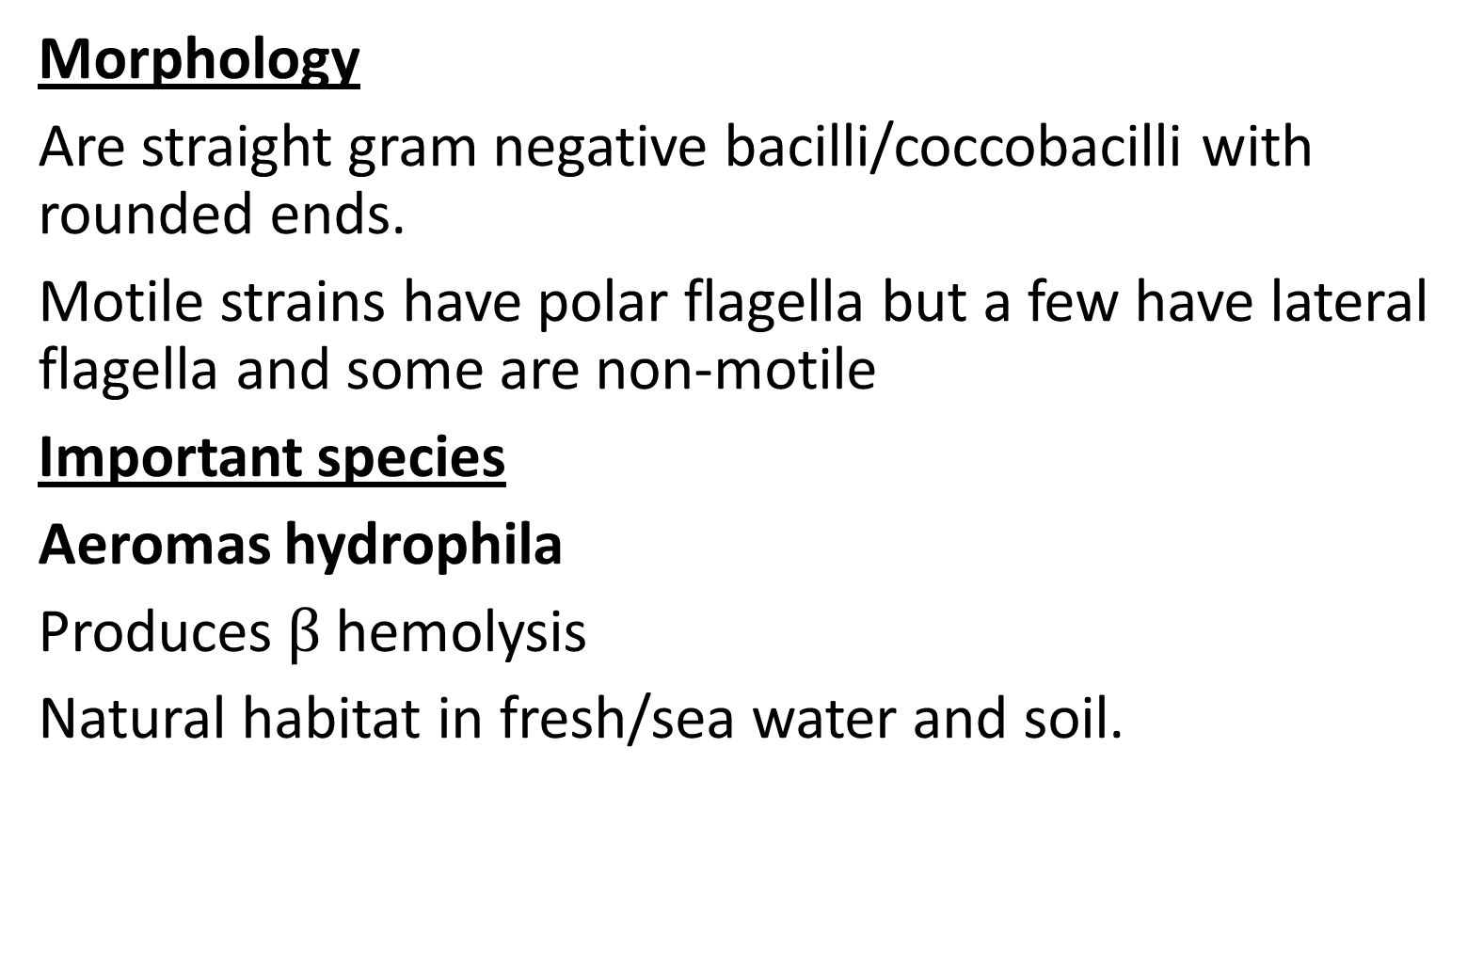
2)Aeromas
Morphology
Are straight gram negative bacilli/coccobacilli with rounded ends.
Motile strains have polar flagella but a few have lateral flagella and some are non-motile
Important species
Aeromas hydrophila
Produces $β$ hemolysis
Natural habitat in fresh/sea water and soil.

Slide 71
Pathogenesis
Cellulitis and wound infections.
Acute diarrheal disease resembling cholera
Septicaemia, ear infection, meningitis and UTI

Slide 72
3)Plesiomonas
Important species
P. shigellodes
Morphology
non-halophillic
Have flagella generally
Isolated in mammals i.e dogs, cats, goats and sheep and in cold-blooded animals i.e frogs, snakes and lizards
Man is infected primarily by ingesting contaminated water and food
Causes; Gastroenteritis, septicaemia, neonatal meningitis, cellulitis and septic arthritis

Slide 73
B) Spirochaetes
Have gram negative type cell wall composed of an outer membrane, a peptidoglycan layer and a cytoplasmic membrane.
Are thin, helical, motile, flexible bacteria, twisted spirally along the long axis giving them the name spirochaetes.
Spira meaning coiled and chaete meaning hair. (refer diag)
Posses a varying number of fine fibrils known as endoflagella

Slide 74
Important genus
i)Treponema pallidum
Morpholgy
Thin, delicate, long, motile, flexible organism which is twisted spirally round its long axis.
Has 4 endoflagella
Pathogenesis
Strict parasite.
Causes syphyllis. (VDRL in ANC)

Slide 75
ii) Leptospira interrogans
Morphology
Actively motile with tightly coiled spiral and hooked ends.
They rotate rapidly along their axes with end foremost.
Pathogenesis
Causes Leptospirosis, a disease affecting the liver, kidney, meninges and conjunctiva.
L. Interrogans are primarily parasites in animals e.g Serovar(subtype) icterohaemorrhagiae is carried by brown rat (rattus norvegicus) which produces a more severe illness known as Weil’s disease (infectious jaundice)

Slide 76
CONT’
Serovar canicola –dog
Serovar Pomona-pig
Serova hardjo-cattle

Slide 77
iii)Borrelia
Are large, motile refractile spirochaetes with 3-10 irregular, wide and open coils.
Important species
a) Borrelia recurrentis
Morphology
Are actively motile, move in forward and backward waves in a cock screw like motion
Are micro-aephillic

Slide 78
Pathogenesis
Causes relapsing fever which is transmitted by infected vectors via body louse (pedicutus corporis)
b) Borrelia burgdorferi
Morphology
Its flexible, helical, microaephillic spirochaete
Pathogenesis
Causes lyme disease-is a vector borne infection transmitted from wild and domestic animals and rodents by ticks (ornithodoros) to man.
Lyme disease is also caused by other Borrelia species to include:
B. duttoni, B. hermsii, B. parkeri and B.turicatae

Slide 79
c)Borellia vincenti
Morphology
Have 3-8 loose coils of variable size.
Are acid-fast with carbol fuchsin.
Normal mouth commensal
Pathogenesis
Causes opportunistic disease known Vincent’s angina (ulcerative condition of the mouth, throat, gums, tongue and oral pharynx.
Causes severe wound infections secondary to animal bite

Slide 80
C) Rickettsiaceae family, Coxiella and Bortonella family
Rickettsiaceae family
Has 3 genera:
Ricketssia
Orientia
Ehrlichia
Morphology
Require an arthropod vector as part of their natural cycle and transmitted to man by blood sucking arthropods

Slide 81
CONT’
Multiply by binary fission.
Posses a trilaminar cytoplasmic membrane and cell wall.
Have both RNA and DNA
Ricketssia
Important species
Ricketssia prowazekii
Transmitted by human body louse causing typhus fever
R.typhi-transmitted by rat flea causing murine typhus
R.rickettsia-transmitted by tick bite causing Rocky mountain spotted fever
R.akari-transmitted by mite causing rickettsial pox

Slide 82
Orientia
Important species
Orientia tsutsugamushi-transmitted by mites causing scrub typhus
Ehrlichia
Important species
Ehrlichia sennetsu-transmitted by ingestion of raw fish causing sennetsu ehrlichiosis (glandular fever)
E.chaffeensis-transmitted by ticks causing fibrile illness with leucopenia affecting bone marrow and liver
E.phagocytophila-transmitted by ticks infecting human granulocytic cell

Slide 83
Coxiella family
Morphology
Grows within the phagolysosome of macrophages of the vertebrate host
Very resistant to heat and drying; remains infectious for months in milk, tap water, soil, dried blood and wool.
Pathogenesis
Causes Q fever transmitted by ticks from domestic animals (sheep, cattle and goats)

Slide 84
Bartonella family
Has two important genus
B.Quintana
Morphology
Non-flagellated, has fimbriae, motile
Proliferates in an extracellular environment in the arthropod host in lumen of the gut rather than within the intestinal epithelial cells
No animal reservoir other than humans
Only transmitted from human to human by body louse
Pathogenesis-causes trench fever (characterized by headache, malaise, fever, chills, back and legs pain)

Slide 85
b) B. henselae
Small, slightly curved
Displays twisting motility
Pathogenesis
Causes cat scratch disease(regional lymphadenopathy and fever following contact, scratch and bite of infected cat)
In HIV pt it causes bacillary angiomatosis(resembling karposis sarcoma)

Slide 86
D)Chlamydiaceae family
Has a single genus known as Chlamydia
Has 4 species;
C.trachomatis
C.psittaci
C.pneumonia
C.pecorum
General characteristics
Small, obligate intracellular bacteria
Have both RNA and DNA, ribosomes and cell wall
Differ from most true bacteria because they do not have peptidoglycan.
They lack ability to produce their own ATP and so use host’s ATP (energy)

Slide 87
CONT’
Multiply in the cytoplasm of the host cell
Infect a wide spectrum of vertebrae host including birds, mammals and humans

Slide 88
Pathogenesis
Chlamydia trachomatis-causes trachoma(chronic keratoconjuctivitis), Ophthamia neonatorum, urethra and cervix infections
C.pneumonia causes acute resp disease in man
C.psittaci causes psittacosis (parrot fever) a disease of parrots & bats but communicable to man
C. pecorum causes lymphogranuloma venereum (veneral disease) characterized by ulceration of external genitalia

Slide 89
E)Mycoplasma
Morphology and general characteristics
Are very small;
Can pass thorugh bacterial filters. Have both DNA & RNA
Differ from other bacteria in that they lack a rigid cell wall
Have a single trilaminar cell membrane that contains a sterol
They cannot synthesize their own cholesterol and require it as a growth factor.
Because they lack a rigid cell wall, they are extremely pleomorphic(varying in shape from coccoid to filamentous and other bizarre forms).

Slide 90
CONT’
Also coz of lack of bacterial cell wall containing peptidoglycan, these organisms are insensitive to cell wall-active antibiotics i.e penicillins and cephalosporins.
They don’t posses flagella or poli, however some like mycoplasma pneumonia exhibit gliding motility by specialized tip structures

Slide 91
Pathogenesis
Causes opportunistic infections to pts with AIDs, cancer and leukaemia
Important species
Mycoplasma pneumonia
Causes trachea bronchitis, pharyngitis, sinusitis and primary atypical pneumonia
Mycoplasma hominis
Causes salpingitis, pelvic abscess, septic arthritis, septic abortion and brain abscess
Mycoplasma genitalium
Cause urethritis and pelvic inflammatory d’se

Slide 92
F) Helicobacter pylori
Morphology
S-shaped, short spirals gram negative rods.
Has lophotrichate flagellae which are sheathed
Pathogenicity
Gastric and duodenal ulcers

Slide 93
G) Legionella
Fastidious gram negative bacteria
Causes disease in human beings only
Transmitted by inhalation of aerosolized water and/or soil contaminated with the bacteria
No person to person spread has been seen
Causes Pontiac fever and leggionaire’s disease

Slide 94
END

Slide 95
VIROLOGY
General properties of viruses
Are the smallest known infective agents
Are obligate intracellular parasites
They infect most forms of life to include animals and plants
The main properties distinguishing viruses from other micro-organisms
Small size-they are smaller than other organisms. Are of various sizes from 10-300 nanometers (nm).
They can pass through bacterial filters and cannot be seen in light microscope. Need to be visualized by an electron microscope

Slide 96
2)Genome
A virus carries its own genetic information in form of either DNA/RNA but NOT both.
The genome may be a single or double-stranded; circular or linear, segmented or unsegmented
3)Metabolically inert
Virus have no metabolic activity outside susceptible host cells.
They don’t posses ribosomes or protein-synthesizing apparatus, although some viruses contain one or more enzymes within their particles
Virus can’t multiply in inanimate media but only inside living cells.
Inside the living cells, the virus genome replicates new virus particles

Slide 97
Structure of the viruses
Viruses consist of nucleic acid core surrounded by a protein coat called capsid.
The capsid with the enclosed nucleic acid is known as nucelocapsid
DNA viruses replicate and are assembled in the nucleus
RNA viruses are assembled in the cytoplasm
Viruses are viable in pH range of 5-9
Antibiotics are ineffective against viruses
ASSIGNMENT
Draw a well labelled diagram of a virus

Slide 98
Classification of Viruses
Is based on the type of nucleic acid, its strandness (double/single) and the size of the viruses
DNA viruses infecting humans
Orthopox virus (Genus)
Smallpox (species)
Morphology-brick-shaped with rounded corners, measuring 250×200×200 nm in size.
Has a biconcave dumbbell shaped DNA
Was globally eradicated in 1980 (WHO)

Slide 99
Simplex virus (genus)
Herpes viruses
Morphology-are 120-200 nm in diameter
Has double-stranded DNA
Important species
Herpes simplex virus type 1 (HSV-1)-primarily infects the mouth (gingivostomatitis), eye(keratoconjuctivitis) and CNS (encephalitis) and causes genital herpes
Herpes simplex virus type 2 (HSV-2)-infects genital and anal regions e.g genital herpes, asceptic meningitis, neonatal infections

Slide 100
Varicellovirus (Genus)
Important species
Varicella zoster virus
Causes Varicella (chickenpox) in children and zoster (shingles) in adults and immunocompromised pts.
Cytomegalovirus
Important species
Human cytomegalovirus
Has DNA. Has huge cytoplasm.
Causes cytoplasmic disease of newborn

Slide 101
Papovirus
Are small naked icosahedra virus (non-enveloped)
Have a double-stranded DNA. Have a diameter of 44-55nm
Important species
Human papillomavirus (wart viruses)
Causes warts at different sites on the human body e.g plantar, common, flat, genital and skin warts

Slide 102
Adenoviridae (adenovirus)
Morphology
Double-stranded DNA genome
Icosahedral, non-enveloped
Measures 70-90 nm
Causes sore-throat, pneumonia, conjunctivitis and meningoenephalitis
Epstein-barr Virus (EB) VIRUS
Causes glandular fever (infectious mononucleosis)

Slide 103
Hepatitis B Virus (HBV)
Morphology
Size 42 nm. Is a DNA virus. Is spherical
Is enveloped, transmitted parenterally, sexually, intrauterine and perinatally

Slide 104
RNA VIRUSES
Hepatitis A
27nm in size. Icosahedral, non-enveloped, transmitted via fecal-oral route. Causes hepatitis A
Hepatitis C
50-60nm, spherical, enveloped, transmitted parenterally and sexually, also perinatally. Causes hep C
Hepatitis D
Measures 36-38µm, icosahedral, enveloped, transmitted parenterally, sexually and perinatally. Causes hepatitis D

Slide 105
Hepatitis E
27-38nm, non-enveloped, transmitted via fecal-oral route, also intra-uterine and perinatal transmission are possible. Causes hep E.
Hepatitis G
Transmitted via parenteral and sexual route. Causes hep G.

Slide 106
ARBOVIRUSES
Are arthropod borne viruses.
Causes arthralgia, haemorrhagic fever and dengue fever (painful bone disease)
Rubella
Has RNA with an envelop. Has nucleicapsid and icosahedral.
Causes German measles affecting pregnant women in first trimester. Congenital rubella may cause microcephally, retinopathy, deafness and patent ductus arteriosus.

Slide 107
Picornaviridae family
The viruses are very small (pico) with RNA. Non-enveloped, icosahedral
Important genus are;
Enterovirus
Has 4 known species
Poliovirus-causes paralytic polio and asceptic meningitis
Coxsackievirus A-causes asecptic meningitis, myocarditis
Echovirus-causes asceptic meningitis, conjunctivitis
Enterovirus-causes hepatitis
b) Rhinovirus-the commonest cause of common cold

Slide 108
Orthomyxoviridae family
This is the family of influenza virus. Measures 80-120nm.
Have RNA genome, enveloped around helical nucleocapsid
Has 3 genera;
Influenza A
Influenza B} causes RTIs & esp pneumonia by type B(immunizable)
Influenza C

Slide 109
Paramyxoviridae family
Pleomorphic with diameter of 150-300nm, helical and has single molecule of RNA.
Has 3 genera pathogenic to man
Paramyxovirus (genus)
Species a) Parainfluenza virus
Causes URTI esp in children
b)Mumps virus
Causes mumps (bilateral inflammation of salivary glands)
ii)Morbillivirus (genus)
Species-Measles virus-causes measles

Slide 110
iii) Pneumovirus
Species; Respiratory syncytial virus-causes bronchiolitis and pneumonia in infancy
Rhabdoviridae family
Important species
Rabies virus
Causes rabies which is a hydrophobia terrifying, fatal communicable disease.
Morphology
Single stranded RNA genome, enveloped, bullet-shaped, measuring 200×80µm. It’s resistant to drying, decay and cold

Slide 111
Reoviridae family
Has two genus.
Rotavirus
Morphology
Segmented double stranded RNA genome. 60-70nm
Spherical in shape (wheel like)
There are 7 serotypes (A-G) with A B C found in human and D E F &G found only in animals.
Pathogenesis
Causes rota virus gastroenteritis (95% of children worldwide are infected within 3-5yrs)
Rota virus vaccine was introduced in Kenya in July 2014

Slide 112
ii) Reovirus
Causes gastroenteritis
FLAVI VIRUS
Morphology
Are spherical, 40-50nm in diameter. Have single stranded RNA genome
Important species
Yellow fever virus-causes yellow fever disease. Transmitted from monkey to man by Aedes aegypti mosquito
ii) Dengue virus-Causes dengue, a haemorrhagic fever disease transmitted by aedes mosquito

Slide 113
RETROVIRIDAE
Human Immundefieciency Virus (HIV)
Morphology
HIV is a spherical enveloped virus about 90-120nm in diameter with a 3 layer structure.
Has two identical copies of RNA associated with reverse transcriptase
Surrounded by an icosahedral capsid.
There are two strains of HIV namely:
HIV-1 which has subgroup M, N & O. Group M is the commonest cause of global epidemic and is sub-divided in 9 subtypes
HIV-2 is divided in 5 subtypes

Slide 114
CONT’
Transmitted via sexual, parenteral and perinatal.
This virus is unique in that it affects only human CD4 (T4) cells lowering immune system.
With the help of reverse transcriptase enzyme, the genetic information is passed on from RNA to DNA.
Pathogenicity
Causes AIDs

Slide 115
Emerging and Re-emerging micro-organisms
Avian Influenza virus(H5N1)-caused pandemic of Avian flu (influenza in 2003). Avian influenza/flu is a viral disease transmitted from birds to human
SARS Virus-causes Sars, a disease characterized by fever, malaise, myalgia, cough and diarrhea
Ebola virus-causes ebola haemorrhagic fever which is a severe fatal viral disease affecting both human and animals (monkeys, gorillas and chipanzees)
Marburg virus-
Westnile virus
Riftvalley virus
H1N1
Zika virus

Slide 116
MYCOLOGY
Mycology is the study of fungi.
Morphology
Fungi are a group of non-motile eukaryotic organisms which exist as saprophytes, parasites or commensals.
They lack chlorophyll and reproduce by means of spores or candida. They produce sexually or asexually.
Classification of Fungi
On the basis of morphology, there are 4 groups of fungi:
Yeasts-are round, oval or elongated unicellular fungi. Most reproduce by an asexual process called budding in which the cell develops a protuberance which enlarges and seperates from parent cell. (diag-stages of budding)

Slide 117
2)Yeast-like
The bud remains attached to the mother cell and elongates, followed by repeated budding, forming chains of elongated cells known as pseudohyphae. Some produce true hyphae.
Diag-pseudohyphae
3)Moulds
In moulds, spores germinate to produce branching filaments called hyphae. (Singular hypha) They are 2-10µm in diameter.
They may be septate or nonseptate (coenocytic)
(diag-septate and aseptate)

Slide 118
CONT’
The hyphae continue to grow and branch to form tangled mass of growth called mycelium.
(Diag)
4)Dimorphic fungi-have a yeast form in the host tissue and in media which is enriched and at temp of 37, but in media at temp of 25 they have hyphal (mycelia) form

Slide 119
PATHOGENIC FUNGI
Dermatophytes
Are filamentous fungi that infects only superficial keratinized tissue.e skin, hair and nails; causing ringworms/tinea/dermatophytosis.
Are classified in 3 genera:
Trichophyton-infects hair, skin and nails
Microsporum-infects hair and skin
Epidermophyton-infects hair and skin
E.GS
Tinea capitis-scalp
Tinea corporis-body

Slide 120
CONT’
Tinea cruris-groin
Tinea pedis-foot
Tinea barbae-beard
Tinea manum-hand
Sporothrix schenckii
Is a dimorphic fungus. It causes sporotrichosis, (a chronic pyogenic granulomatous infection of the skin and subcutaneous tissues)
Histoplasma capsulatum
Is a dimorphic fungus causing histoplasmosis (an intracellular mycosis of reticuloendothelial system)

Slide 121
Coccidioides immitis
A dimorphic fungus causing coccidioidomycosis (primary infection of the lungs)
Candida albicans
Are budding yeast cells with pseudohyphae, spherical or oval shaped, measuring 3-5µm in diameter. It can also produce true hyphae.
Causes candidiasis (is the commonest mycosis involving skin, mucosa and internal organs)
E.Gs Mucocutaneous lesions
Oral candidiasis (oral thrush)
Oesophageal candidiasis
Vulvovaginitis

Slide 122
CONT’
Balanitis (male external genitalia)
Conjuctivitis and keratitis
Systemic Candidiasis
Urinary candidiasis
Pulmonary candidiasis
Meningitis
Endocarditis
Osteomyelitis

Slide 123
Cryptococcus neoformans
Causes a disease known as cryptococcosis-an opportunistic infection affecting CNS, skin, mucosa, bones and other organs e.g pulmonary cryptococcosis, cryptococcal meningitis.
Morphology-encapsulated yeast, budding yeast cell and 4-10µm in diameter.

Slide 124
Aspergillus
Important pathogens/species
Aspergillus fumigatus
Aspergillus flavus
niger
Aspergillus Terreus
Nidulans
Are 3-5µm in diameter. They have septate hyphae with characteristic dichotomous branching. Causes aspergillosis

Slide 125
Zygomycetes
Are saprophytic fungi, have broad nonseptate hyphae which are irregularly branched and 7-15µm in diameter.
They cause zygomycosis or mucormycosis; an opportunistic infection
Rhinosporidium seeberi
Causes rhinosporidiosis, a chronic granulomatous disease

Slide 126
END

Slide 127
PARASITOLOGY
Parasitology is the area of biology concerned with the phenomenon of dependence of one living organism on another.
A parasite is an animal or plant which lives in or upon another organism and derives its nutrient directly from it.
Classification of parasites
Are classified into;
Protozoa-(unicellular organism) performs all functions
Helminths-(multicellular organism) each cell performs a particular function

Slide 128
PROTOZOA
Groups that are pathogenic to man include;
Sarcodina family
Amoebae
Important species
Entamoeba histolytica
Morphology
These parasites exist in 3 forms namely; trophozoites, precyst and cyst.
Lifecycle-passes its life cycle in only one host
Man acquires infection by ingestion of water and contaminated food by mature cysts.

Slide 129
Pathogenicity
Causes intestinal and extraintestinal amoebiasis.
b) Entamoeba coli-commensal in man’s large intestine
c)Entamoeba gingivalis-commensal in man’s teeth and gingival tissue

Slide 130
2) Mastigophora family
Group; flagellates
Are flagellated
Important genus
Giardia lamblia (G)
It lives attached to the mucosal surface of the small intestines of man. It exists in trophozoite and cyst stages.
Life cycle-it passes its life cycle in one host
Man aquires infection by ingestion of water and food contaminated with the cysts
Pathogenicicty-causes Giardiasis (non-bloody diarrhea)

Slide 131
b) Trichomonas
Are flagellated with 4 anterior flagella and one lateral flagellum.
Has 3 species which occur in humans.
Trichomonas tenax-it’s a commensal of the human mouth. Causes abscess in gums and tonsillar glands. Transmitted by kissing, salivary droplets and fomites
Trichomonas hominis-it inhabits the caecum of man, it does not invade the intestinal mucosa.
Pathogenicity-occasionally causes diarrhea
Trichomonas vaginalis-are normal habitat parasites in the vagina, urethra of women and in the male urethra, seminal vesicles and prostate.
It’s transmitted by sexual intercourse

Slide 132
CONT’
Pathogenicity-causes Trichomoniasis (vulvovaginitis), characterized by foamy greenish/yellow discharge with itching.
In male, have mild infections, i.e balanitis and urethritis
c) Trypanosoma
Important species
Trypanosoma brucei gambiense
Causes chronic type of trypanosomiasis/sleeping sickness transmitted to man by tsetse fly (Glossing fly)
Trypanosoma brucei rhodesiense
Causes acute and rapid progressive trypanosomiasis

Slide 133
d) Leishmania ssp
Important species
Leishmania donovani
Causes visceral leishmaniasis (Kalaazer) transmitted by sandflies. (severe chronic infection of the reticulo-endothelial system presenting with fever, chills, leukopenia, splenomegaly and weight loss.
Leishmania tropica
Causes cutaneous Leishmaniasis (swelling appearing on the skin like keloid), transmitted by sandflies
Leishmania braziliens-Hosted by canines and rodents; transmitted to man by sandflies. Causes mucocutaneous lesion on the mucous membrane and the skin

Slide 134
3)Sporozoa family
Important Genus
Plasmodium
Are malaria parasites, they exhibit a complex life cycle involving alternating cycles of asexual division in man and sexual development occurring in female anopheles mosquito. Produce spore like oocysts.
Has 4 species;
Plasmodium vivax-causes benign tertian malaria
Plasmodium malariae-causes quartam malaria
Plasmodium falciparum-causes malignant tertian malaria
Plasmodium ovale-causes ovale tertian malariax

Slide 135
4) Ciliophoria Family
Have cilia for locomotion
Have both asexual and sexual life cycles
Are parasites of gut lumen but also invade tissues
Important Species
Balantidium coli
Is the largest intestinal protozoa and the only ciliated protozoa
Has one nuclear
Exist in both vegetative and cyst form
Causes balantidiasis (mild dysentery)

Slide 136
HELMIMTHS
Are parasitic worms; not independent outside the host.
Are divided into 2 major groups;
Nematodes (round worms)
Platyhelminths (flat worms)-which is divided into Trematodes (flukes) and cestodes (tapeworms)

Slide 137
1)NEMATODES (ROUND WORMS)
They are elongated, cylindrical, unsegmented.
Separate male and female
Have body cavity
Important species
Enterobius Vermicularis (Threadworm)
Live in human caecum, vermiform appendix and ascending colon.
Has a simple life cycle completed in a single host.

Slide 138
Pathogenicity
Causes nocturnal perianal and perineal pruritis, appendicitis, vulvovaginitis and salpingitis
ii) Ascaris lumbricoides(common roundworm)
Adult worm resides in the small intestine in man. Is the largest intestinal nematode in man.
Resembles an ordinary earthworm
Lifecycle-passed in one host only i.e man
Pathogenicity-causes ascariasis

Slide 139
iii)Human hookworms
Adult worms reside in small intestine mostly in jejunum and sometimes in ileum and duodenum.
They are two species namely;
Ancylostoma duodenale (old world hookworm)
Man is the only host.
They penetrate through unbroken skin
They cause ancylostoma duodenale infection
b) Necator Americanus(new world hookworm)
Are slightly smaller and thinner than A duodenale but have the same life cycle and pathogenicity.

Slide 140
iv)Wucheria bancrofti(Bancroft’s filaria)
Adult worms inhabit lymph nodes and lymphatic vessels of man.
Passes its life cycle in 2 hosts-man and female mosquitoes (either) culex, aedes or anopheles
Pathogenicity-causes wuchereriasis or filariasis or elephantiasis

Slide 141
2)PLATYHELMINTHS
1) CESTODES (TAPEWORMS)
Tap-like segmented
Sexes not separate. Alimentary canal absent. Body cavity absent
Important species
Taenia saginata (beef tapeworm)
The adult worms live in small intestine.
It is passed in two hosts; Definitive host is man and immediate host is cow and buffalo
5-10 metres

Slide 142
ii)Taenia solium(pork tapeworm)
Shorter than saginata, 2-3 metres
The immediate host is pig and definitive man
Infects man by ingestion of undercooked pork
Causes cysticerosis
iii)Enchinococcus granulosus (dog tapeworm)
Also found in sheep and cattle which are intermediate host and man definitive host.
Very small tapeworm measuring 3-6nm in length. Pathogenicity-Causes enchinococcosis or hydatid cyst

Slide 143
2)TREMATODES(FLUKES)
Examples;
Fasciola
Schistosoma-causes schistosommisis/bilharzias
Threadworms

Slide 144
END
THANKYOU

